Slide 1
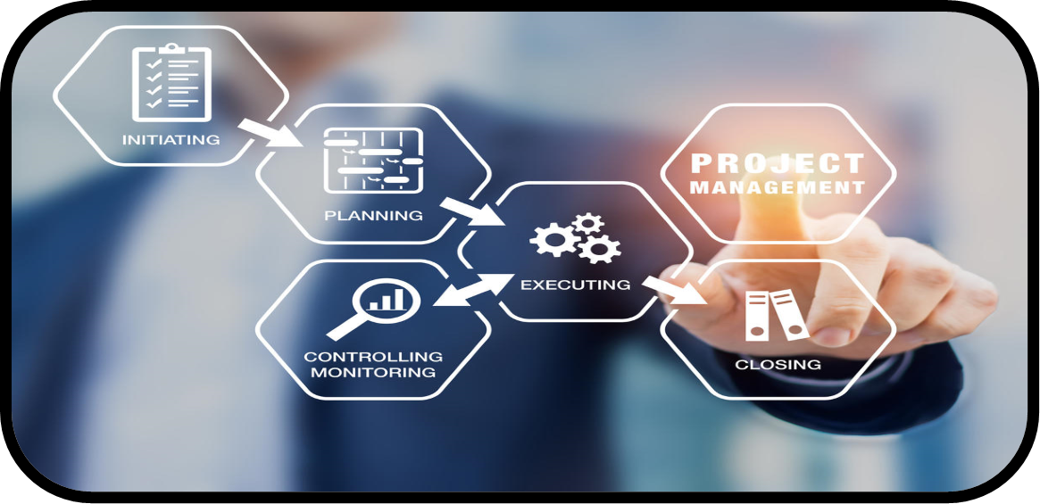
Project’s Definition and Life Cycle

Slide 2
Project vs Non Project

Slide 3
Project’s Definition
Projects are unique and non-repetitive.
A project must have a substantial goal.
Projects are temporary in nature and have a definite beginning and ending date.
Projects are completed when the project goals are achieved.
A successful project is one that meets or exceeds the expectations of your stakeholders.
A project is defined as a “temporary endeavor with a beginning and an end and it must be used to create a unique product, service or result”.

Slide 4
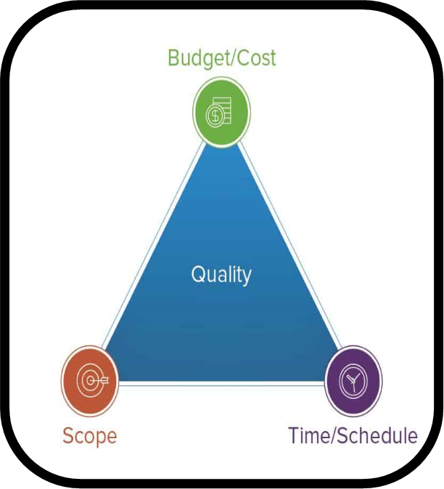
Triple Constraints
Time
Cost
Scope

Slide 5
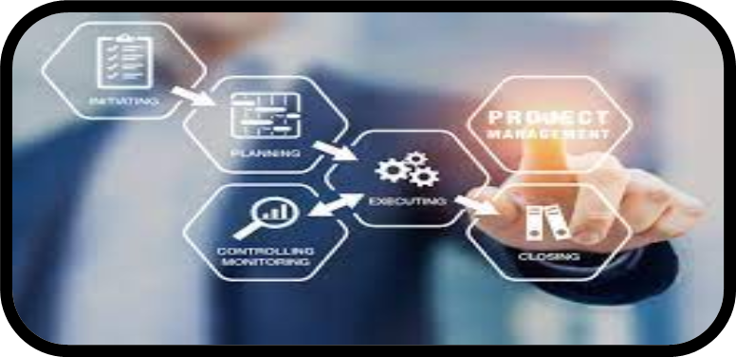
Project Management:
“A set of tools and techniques, performed by people, to describe, organize, and monitor, the work of project activities.”

Slide 6
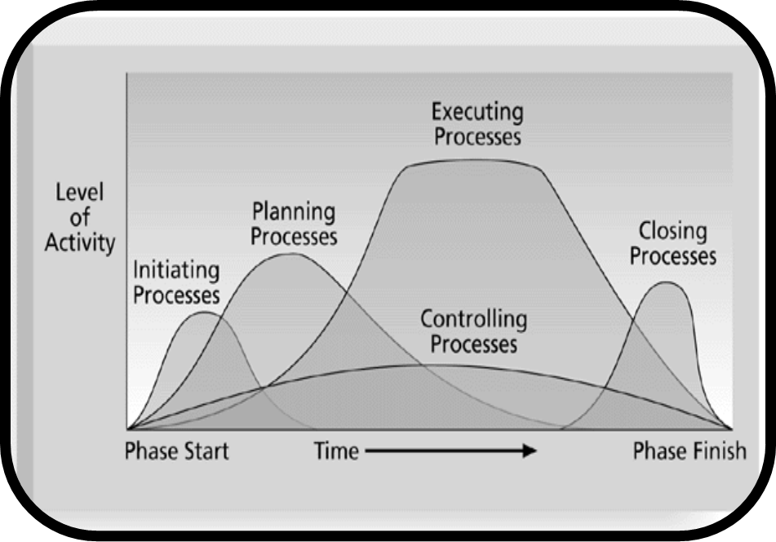
Project Life Cycle
Defining
Planning
Executing
Controlling
Closing

Slide 7
Project Life Cycle : Defining
Problem or opportunity being addressed
Goal of the project
Objectives needed to accomplish the goal
Criterion of determining success
Assumptions or Risks identified

Slide 8
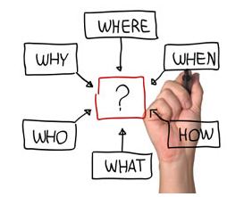
Project Life Cycle : Planning
Roadmap of the how the work will be done
Always dynamic
What to do?
Why to do?
When to do?
What resources are needed?
Benefits of Planning
Reduces Uncertainty
Increases Understanding
Improves Efficiency

Slide 9
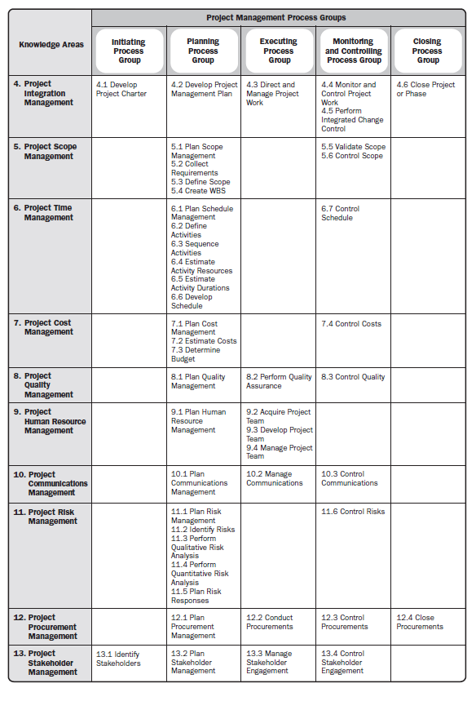

Slide 10
Project Life Cycle : Executing
(Referred to as Organizing)
Organizing People
Identification of Specific resources
Scheduling workers to activities
Scheduling activities

Slide 11
Project Life Cycle : Controlling
Monitor project progress and slips
Look ahead for potential problems
Handle Change

Slide 12
Project Life Cycle : Closing
Did the project do what the requestor said it would do?
Did the project do as specified by the project manager?
Was the project completed according to plan?
What helpful information was collected?
How well the project plan was followed?

Slide 13
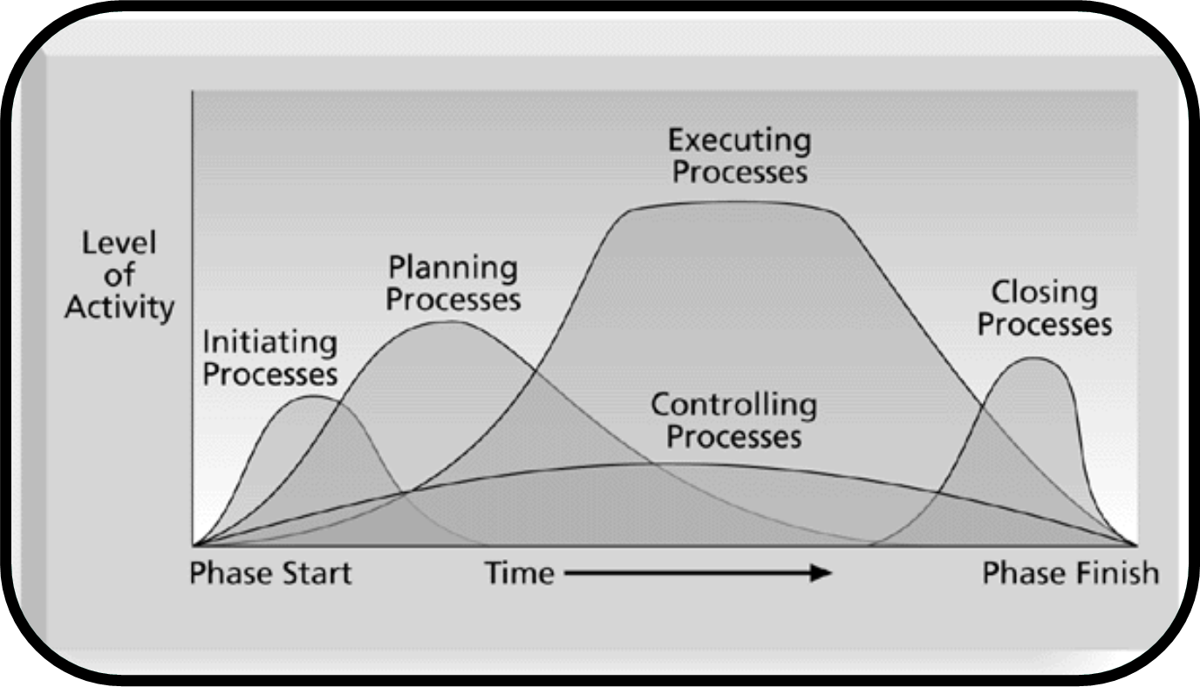
Concluding Remarks:

Slide 14
The End

